Slide 1
{
"frames": {
The components of your study
Likely not in the order that is presented
There are lots of templates on the Github (https://lookit.github.io/lookit-frameplayer-docs/modules/frames.html)
"sequence": [
"video-config",
"pre-study",
"video-consent",
"instructions-preview",
"final-instructions",
"cam-setup",
"webcam-display",
"test-trials",
"exit-survey"
The actual order for your study
Notes:
Slides by Nicole Cuneo – please credit if reusing portions!

Slide 2
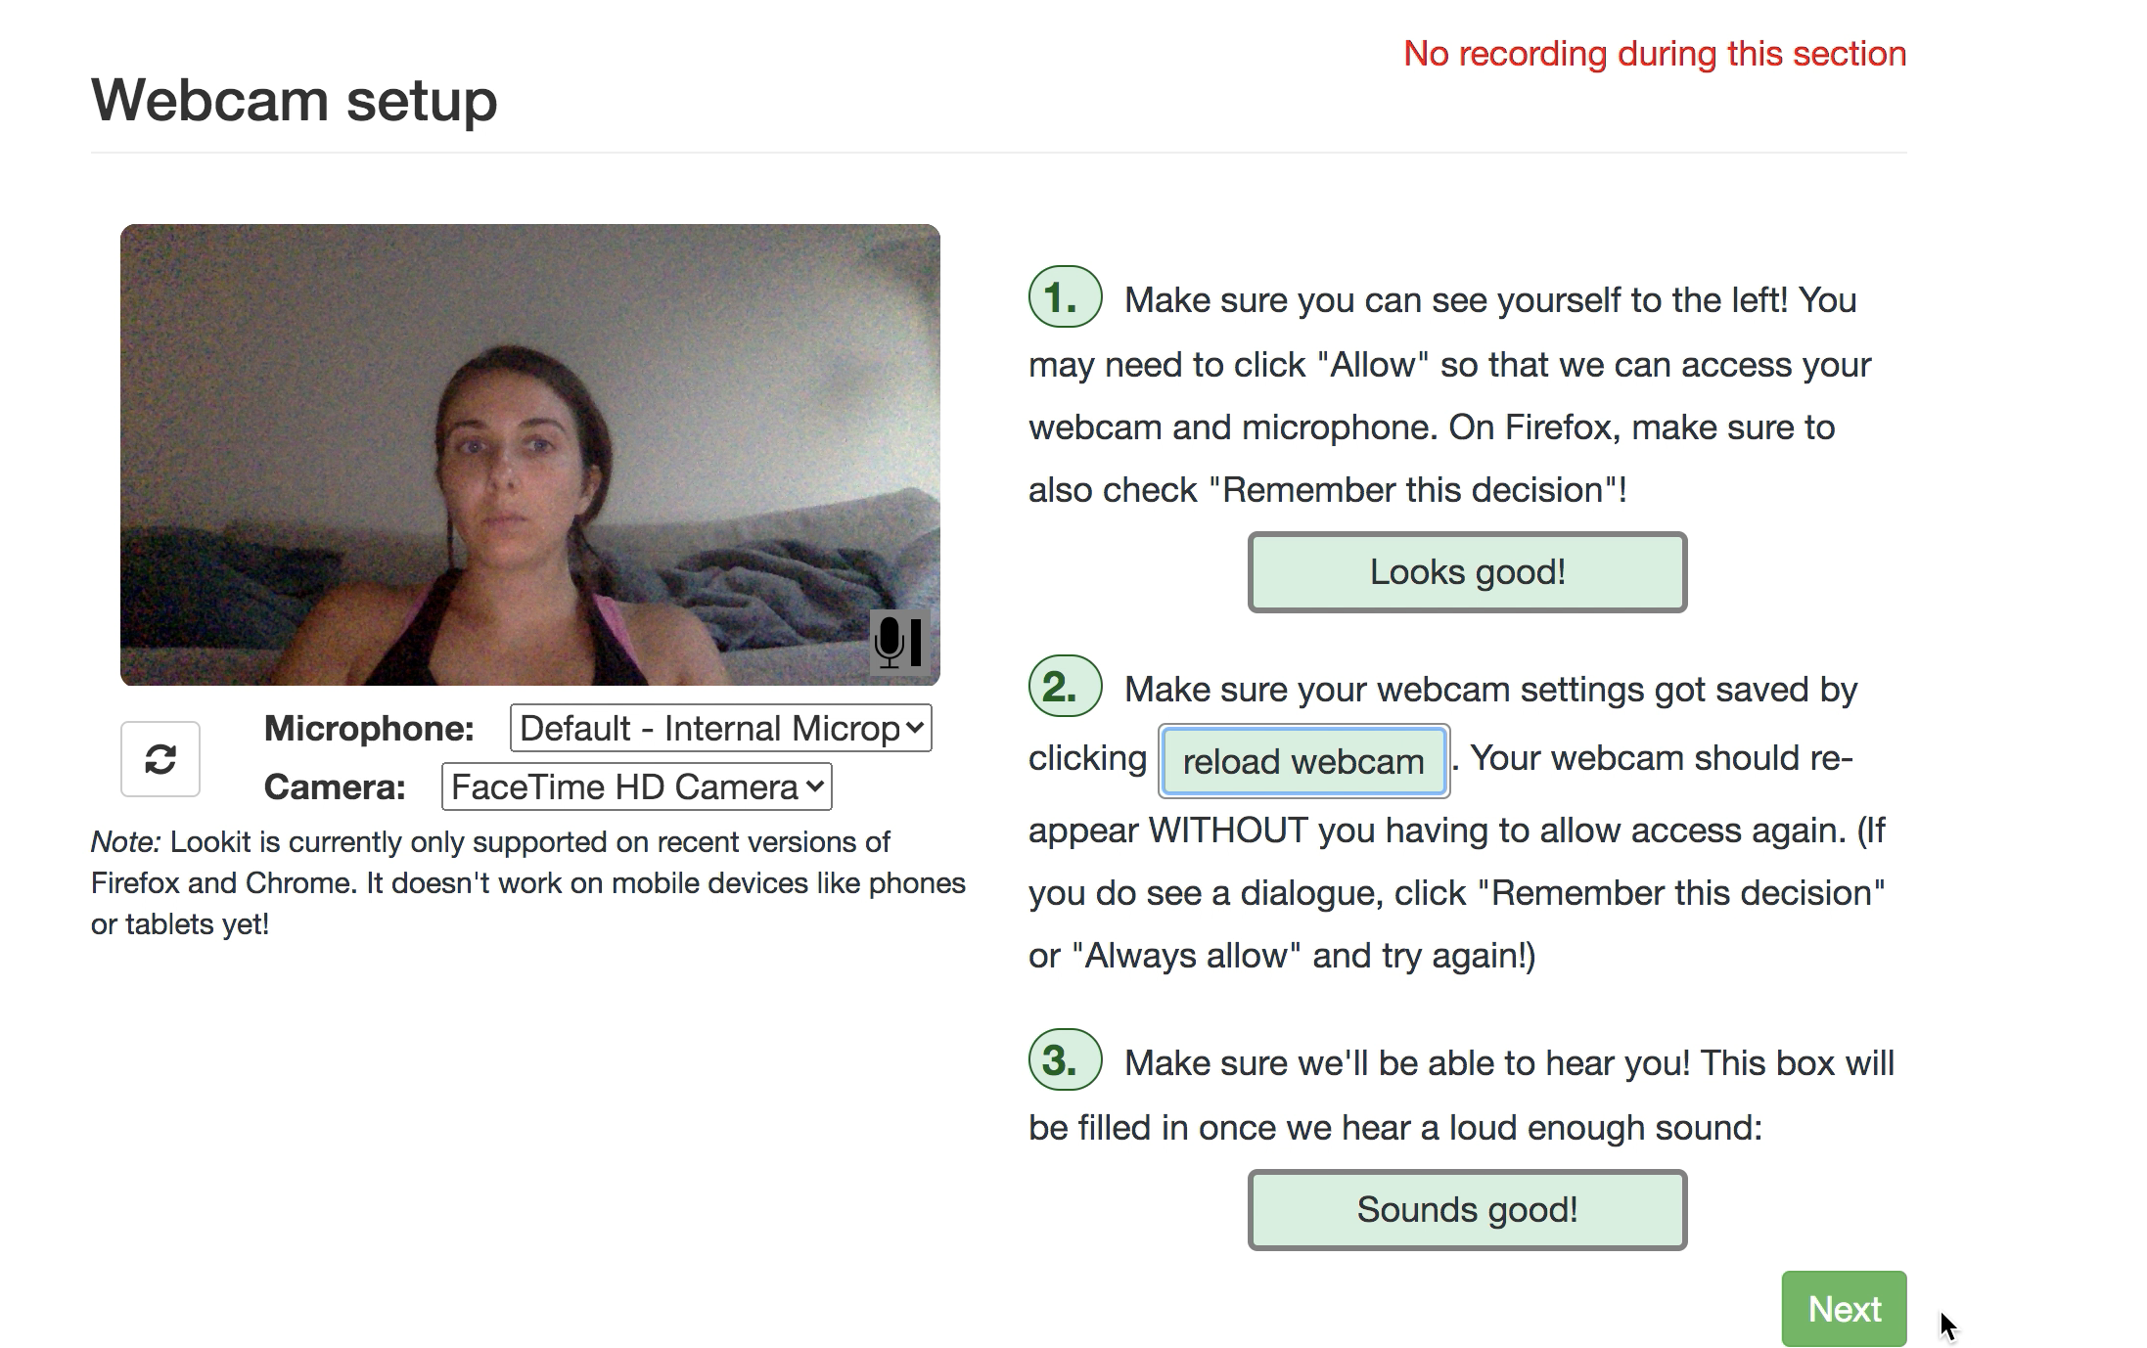
"sequence": [
"video-config",
"pre-study",
"video-consent",
"instructions-preview",
"final-instructions",
"cam-setup",
"webcam-display",
"test-trials",
"exit-survey"

Slide 3
"sequence": [
"video-config",
"pre-study",
"video-consent",
"instructions-preview",
"final-instructions",
"cam-setup",
"webcam-display",
"test-trials",
"exit-survey"
All 3 of these buttons need to be green in order to progress. This ensures that the camera and mic are working, and that if for some reason the browser refreshes, the camera/mic can be found again

Slide 4
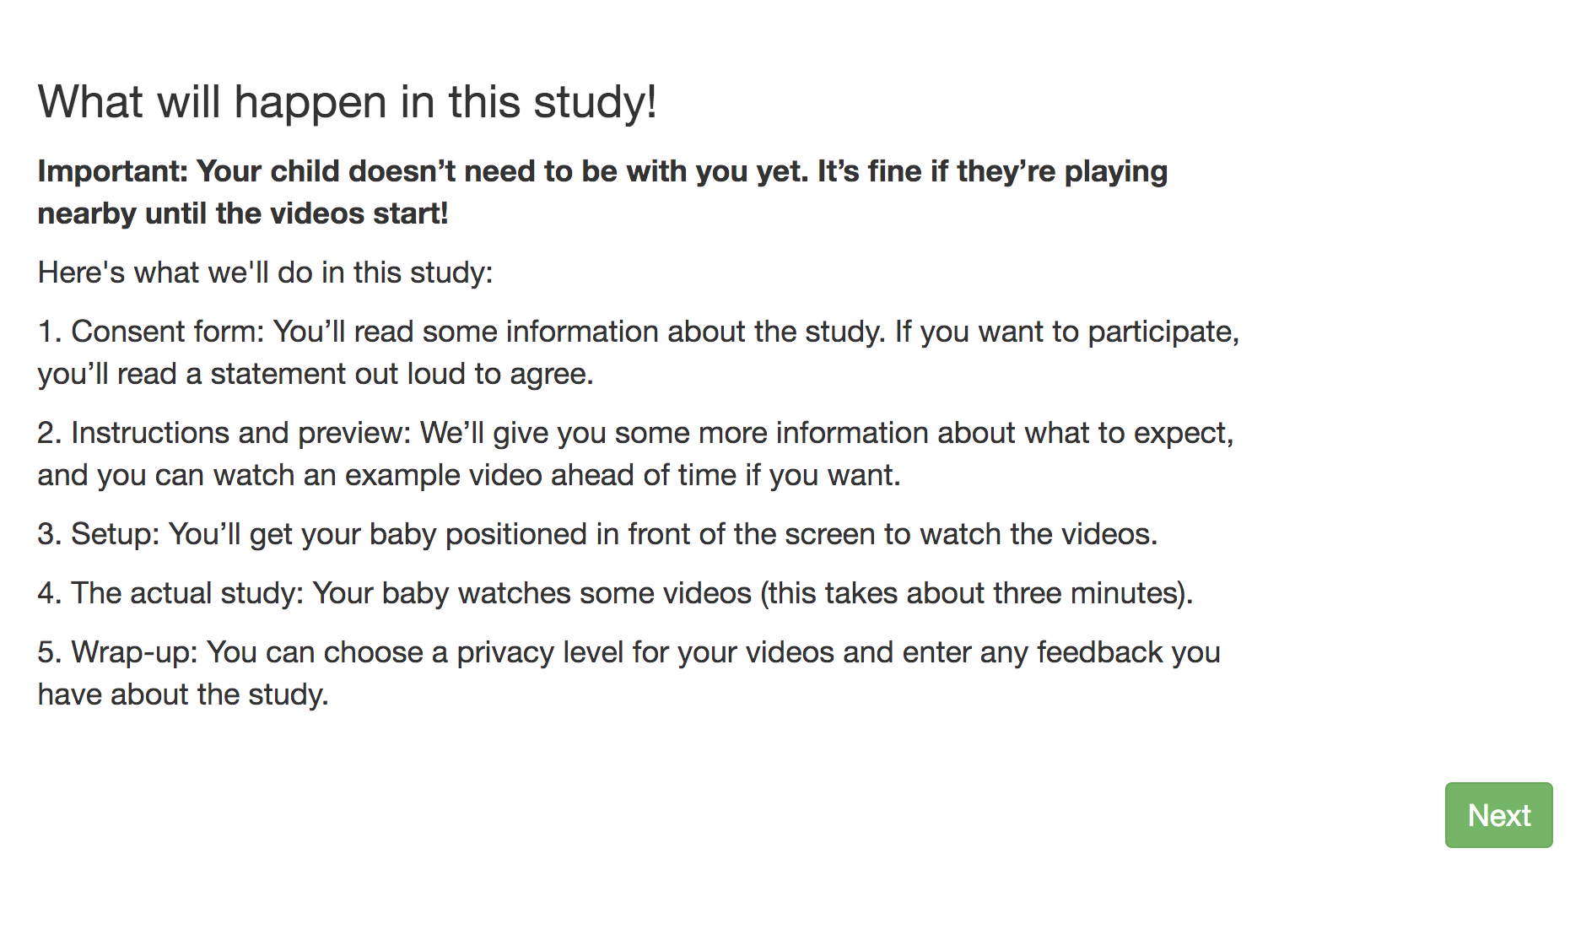
"sequence": [
"video-config",
"pre-study",
"video-consent",
"instructions-preview",
"final-instructions",
"cam-setup",
"webcam-display",
"test-trials",
"exit-survey"

Slide 5
CODE
LOOKIT VIEW
"pre-study": {
"kind": "exp-lookit-text",
"blocks": [
{
"emph": true,
"text": "Important: Your baby doesn’t need to be with you yet. It’s fine if your baby is playing nearby until the videos start!",
"title": "What will happen in this study!"
},{
"text": "Here's what we'll do in this study:"
},
{
"text": "1. Consent form: You’ll read some information about the study. If you want to participate, you’ll read a statement out loud to agree."
},
{
"text": "2. Instructions and preview: We’ll give you some more information about what to expect, and you can watch an example video ahead of time if you want."
},
{
"text": "3. Setup: You’ll get your baby positioned in front of the screen to watch the videos."
},
{
"text": "4. The actual study: Your baby watches some videos (this takes about three minutes)."
},
{
"text": "5. Wrap-up: You can choose a privacy level for your videos and enter any feedback you have about the study."
}
],

Slide 6
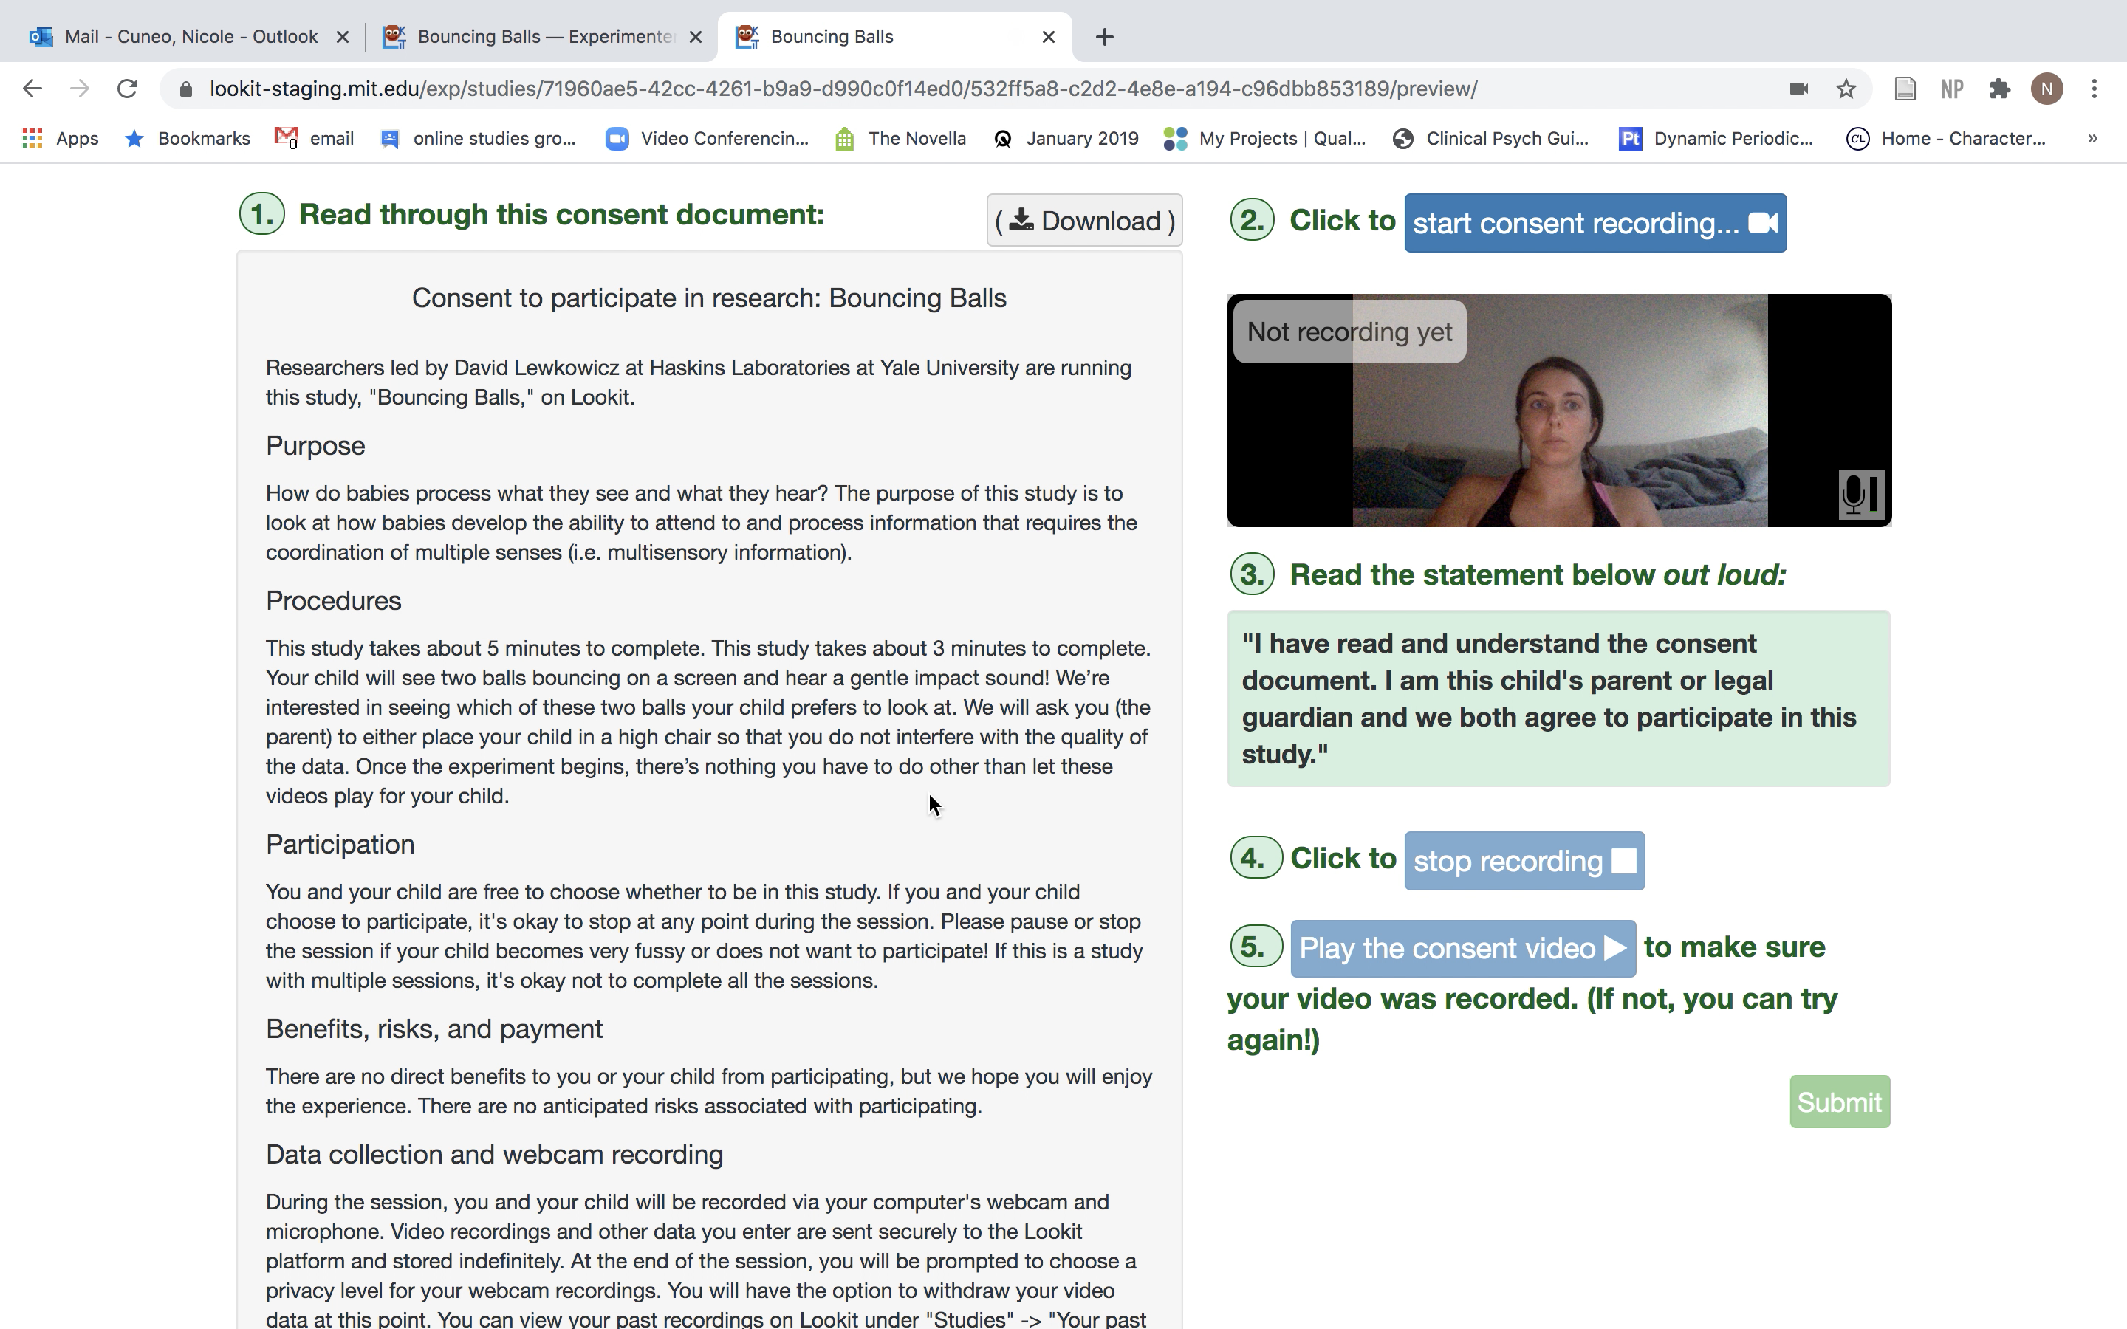
"sequence": [
"video-config",
"pre-study",
"video-consent",
"instructions-preview",
"final-instructions",
"cam-setup",
"webcam-display",
"test-trials",
"exit-survey"

Slide 7
CODE
LOOKIT VIEW
"video-consent": {
"gdpr": false,
"kind": "exp-lookit-video-consent",
"PIName": "David Lewkowicz",
"datause": "How do babies process what they see and what they hear? The purpose of this study is to look at how babies develop the ability to attend to and process information that requires the coordination of multiple senses (i.e. multisensory information).",
"payment": "There are no direct benefits to you or your child from participating, but we hope you will enjoy the experience. There are no anticipated risks associated with participating.",
"purpose": "How do babies process what they see and what they hear? The purpose of this study is to look at how babies develop the ability to attend to and process information that requires the coordination of multiple senses (i.e. multisensory information).",
"template": "consent_003",
"PIContact": "David Lewkowicz at 203-865-6163 ext. 215.",
"procedures": "This study takes about 3 minutes to complete. Your child will see two balls bouncing on a screen and hear a gentle impact sound! We’re interested in seeing which of these two balls your child prefers to look at. We will ask you (the parent) to either place your child in a high chair so that you do not interfere with the quality of the data. Once the experiment begins, there’s nothing you have to do other than let these videos play for your child.",
"institution": "Haskins Laboratories at Yale University",
"additional_segments": [
{
"text": "Lookit is a U.S. organization and all information gathered from the website is stored on servers based in the U.S. Therefore, your video recordings are subject to U.S. laws, such as the US Patriot Act. This act allows authorities access to the records of internet service providers. If you choose to participate in this study, you understand that your video recording will be stored and accessed in the USA. The security and privacy policy for Lookit can be found at the following link: <a href='https://lookit.mit.edu/privacy/' target='_blank'>https://lookit.mit.edu/privacy/</a>.",
"title": "US Patriot Act Disclosure"
}
],
"research_rights_statement": "You are not waiving any legal claims, rights or remedies because of your participation in this research study. If you feel you have been treated unfairly, or if you have any questions concerning your rights as a research subject, you may contact the Human Investigation Committee at (203) 785-4688. If after you have verbally consented to this form you have any questions about your privacy rights, please contact the Yale Privacy Officer at 203/436-3650."
}

Slide 8
CODE
LOOKIT VIEW
"video-consent": {
"gdpr": false,
"kind": "exp-lookit-video-consent",
"PIName": "David Lewkowicz",
"datause": "How do babies process what they see and what they hear? The purpose of this study is to look at how babies develop the ability to attend to and process information that requires the coordination of multiple senses (i.e. multisensory information).",
"payment": "There are no direct benefits to you or your child from participating, but we hope you will enjoy the experience. There are no anticipated risks associated with participating.",
"purpose": "How do babies process what they see and what they hear? The purpose of this study is to look at how babies develop the ability to attend to and process information that requires the coordination of multiple senses (i.e. multisensory information).",
"template": "consent_003",
"PIContact": "David Lewkowicz at 203-865-6163 ext. 215.",
"procedures": "This study takes about 3 minutes to complete. Your child will see two balls bouncing on a screen and hear a gentle impact sound! We’re interested in seeing which of these two balls your child prefers to look at. We will ask you (the parent) to either place your child in a high chair so that you do not interfere with the quality of the data. Once the experiment begins, there’s nothing you have to do other than let these videos play for your child.",
"institution": "Haskins Laboratories at Yale University",
"additional_segments": [
{
"text": "Lookit is a U.S. organization and all information gathered from the website is stored on servers based in the U.S. Therefore, your video recordings are subject to U.S. laws, such as the US Patriot Act. This act allows authorities access to the records of internet service providers. If you choose to participate in this study, you understand that your video recording will be stored and accessed in the USA. The security and privacy policy for Lookit can be found at the following link: <a href='https://lookit.mit.edu/privacy/' target='_blank'>https://lookit.mit.edu/privacy/</a>.",
"title": "US Patriot Act Disclosure"
}
],
"research_rights_statement": "You are not waiving any legal claims, rights or remedies because of your participation in this research study. If you feel you have been treated unfairly, or if you have any questions concerning your rights as a research subject, you may contact the Human Investigation Committee at (203) 785-4688. If after you have verbally consented to this form you have any questions about your privacy rights, please contact the Yale Privacy Officer at 203/436-3650."
}
The parent must play the consent form in order to submit the consent (That way the participant can see if there were any issues! This is important because the consent video must be clear in order to use the data)

Slide 9
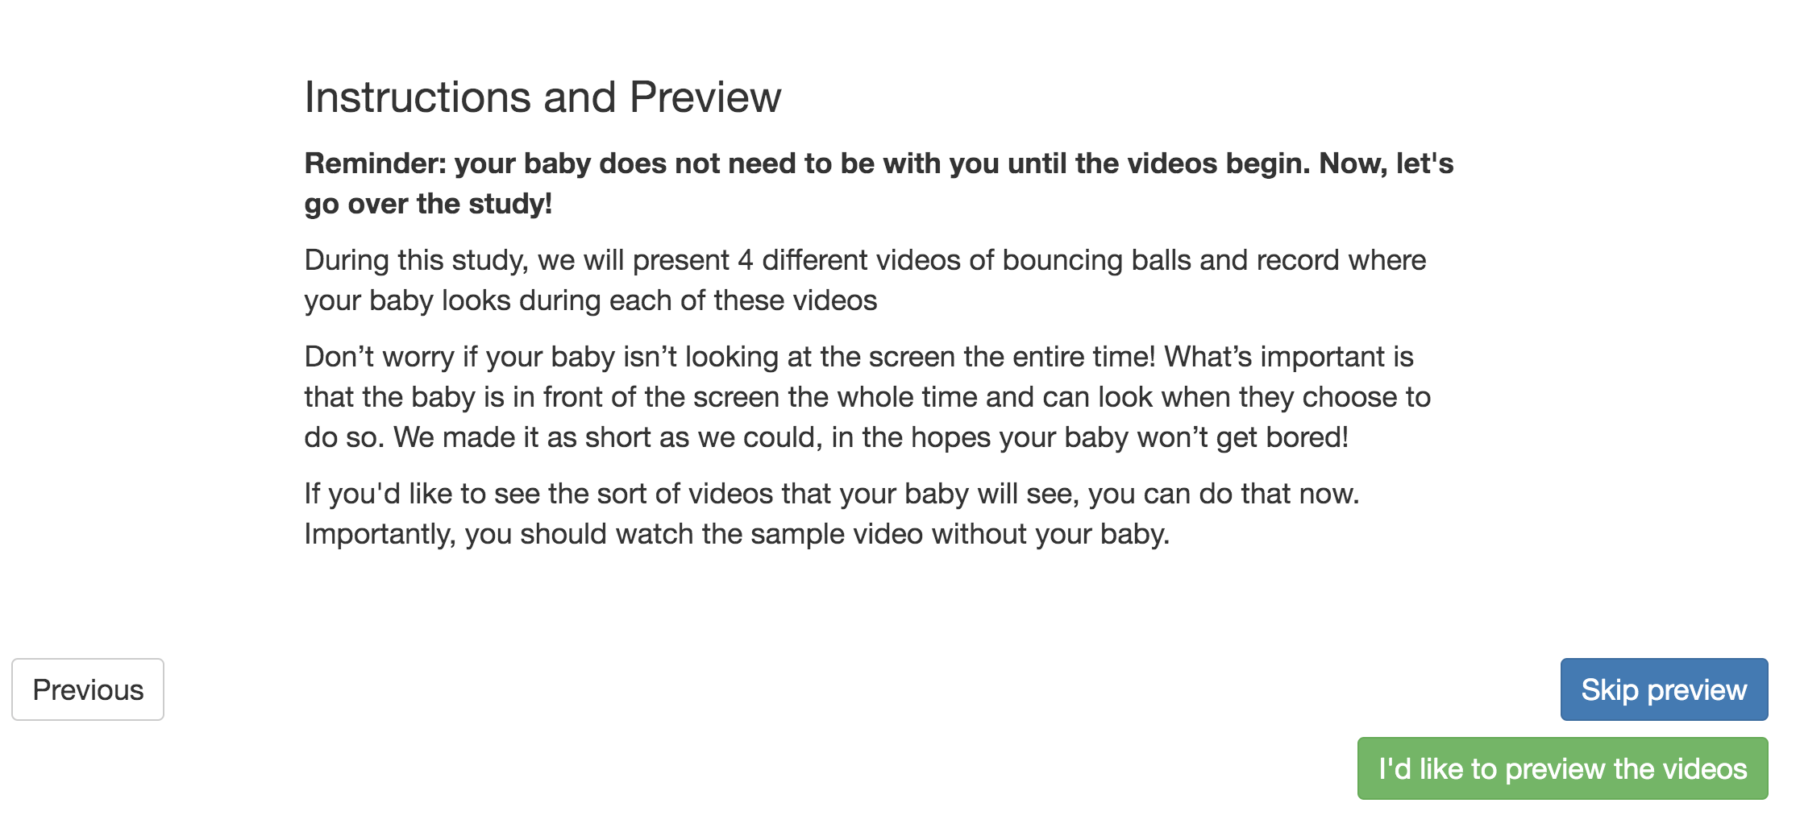
"sequence": [
"video-config",
"pre-study",
"video-consent",
"instructions-preview",
"final-instructions",
"cam-setup",
"webcam-display",
"test-trials",
"exit-survey"

Slide 10
"instructions-preview": {
"kind": "exp-lookit-stimuli-preview",
"blocks": [
{
"emph": true,
"title": "Instructions and Preview"
},
{
"emph": true,
"text": "Reminder: your baby does not need to be with you until the videos begin. Now, let's go over the study!"
},
{
"text": "During this study, we will present 4 different videos of bouncing balls and record where your baby looks during each of these videos"
},
{
"text": "Don’t worry if your baby isn’t looking at the screen the entire time! What’s important is that the baby is in front of the screen the whole time and can look freely. We made it as short as we could, in the hopes your baby won’t get bored! "
},
{
"text": "If you'd like to see the sort of videos that your baby will see, you can do that now. Importantly, you should watch the sample video without your baby."
}
],
"baseDir": "https://raw.githubusercontent.com/ncuneo0711/lookit-stimuli-template/master/",
"stimuli": [
{
"video": "Sample",
"caption": "Here's a sample of what one of the videos will look like! Please note, the boucing balls in the video you see may be a different color!"
}
],
"videoTypes": [
"webm",
"mp4"
],
"skipButtonText": "Skip preview",
"previewButtonText": "I'd like to preview the videos",
"showPreviousButton": true
CODE
LOOKIT VIEW

Slide 11
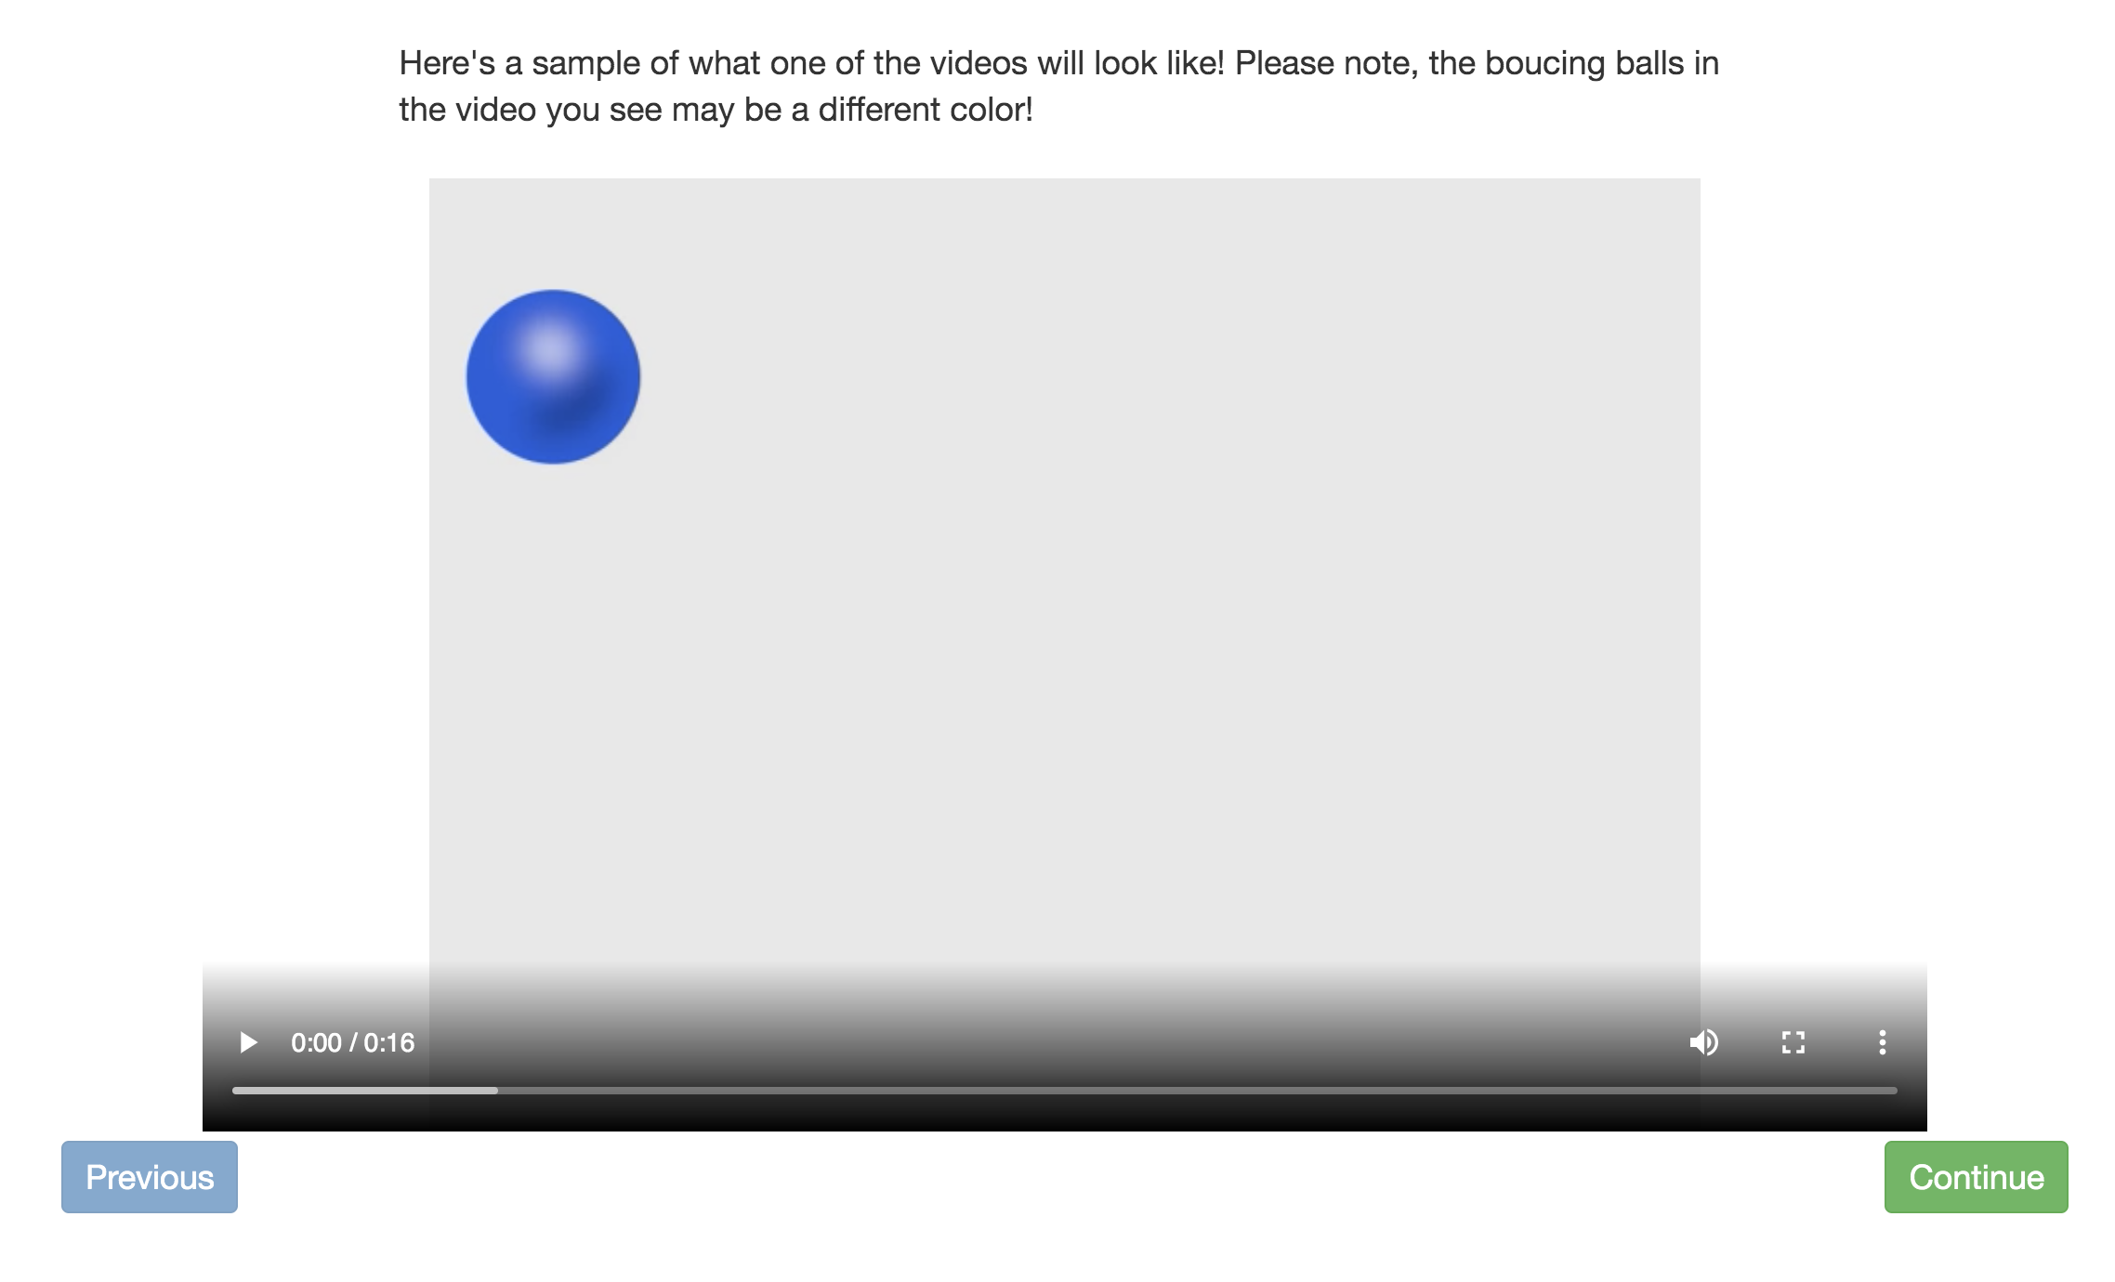
"instructions-preview": {
"kind": "exp-lookit-stimuli-preview",
"blocks": [
{
"emph": true,
"title": "Instructions and Preview"
},
{
"emph": true,
"text": "Reminder: your baby does not need to be with you until the videos begin. Now, let's go over the study!"
},
{
"text": "During this study, we will present 4 different videos of bouncing balls and record where your baby looks during each of these videos"
},
{
"text": "Don’t worry if your baby isn’t looking at the screen the entire time! What’s important is that the baby is in front of the screen the whole time and can look freely. We made it as short as we could, in the hopes your baby won’t get bored! "
},
{
"text": "If you'd like to see the sort of videos that your baby will see, you can do that now. Importantly, you should watch the sample video without your baby."
}
],
"baseDir": "https://raw.githubusercontent.com/ncuneo0711/lookit-stimuli-template/master/",
"stimuli": [
{
"video": "Sample",
"caption": "Here's a sample of what one of the videos will look like! Please note, the boucing balls in the video you see may be a different color!"
}
],
"videoTypes": [
"webm",
"mp4"
],
"skipButtonText": "Skip preview",
"previewButtonText": "I'd like to preview the videos",
"showPreviousButton": true
CODE
LOOKIT VIEW

Slide 12
"instructions-preview": {
"kind": "exp-lookit-stimuli-preview",
"blocks": [
{
"emph": true,
"title": "Instructions and Preview"
},
{
"emph": true,
"text": "Reminder: your baby does not need to be with you until the videos begin. Now, let's go over the study!"
},
{
"text": "During this study, we will present 4 different videos of bouncing balls and record where your baby looks during each of these videos"
},
{
"text": "Don’t worry if your baby isn’t looking at the screen the entire time! What’s important is that the baby is in front of the screen the whole time and can look freely. We made it as short as we could, in the hopes your baby won’t get bored! "
},
{
"text": "If you'd like to see the sort of videos that your baby will see, you can do that now. Importantly, you should watch the sample video without your baby."
}
],
"baseDir": "https://raw.githubusercontent.com/ncuneo0711/lookit-stimuli-template/master/",
"stimuli": [
{
"video": "Sample",
"caption": "Here's a sample of what one of the videos will look like! Please note, the boucing balls in the video you see may be a different color!"
}
],
"videoTypes": [
"webm",
"mp4"
],
"skipButtonText": "Skip preview",
"previewButtonText": "I'd like to preview the videos",
"showPreviousButton": true
CODE
LOOKIT VIEW
(This allows for parents to preview the study beforehand. They’re told to *not* have their child at this time but since we can’t be sure I would tweak the stimuli so they’re not the exact same!)

Slide 13
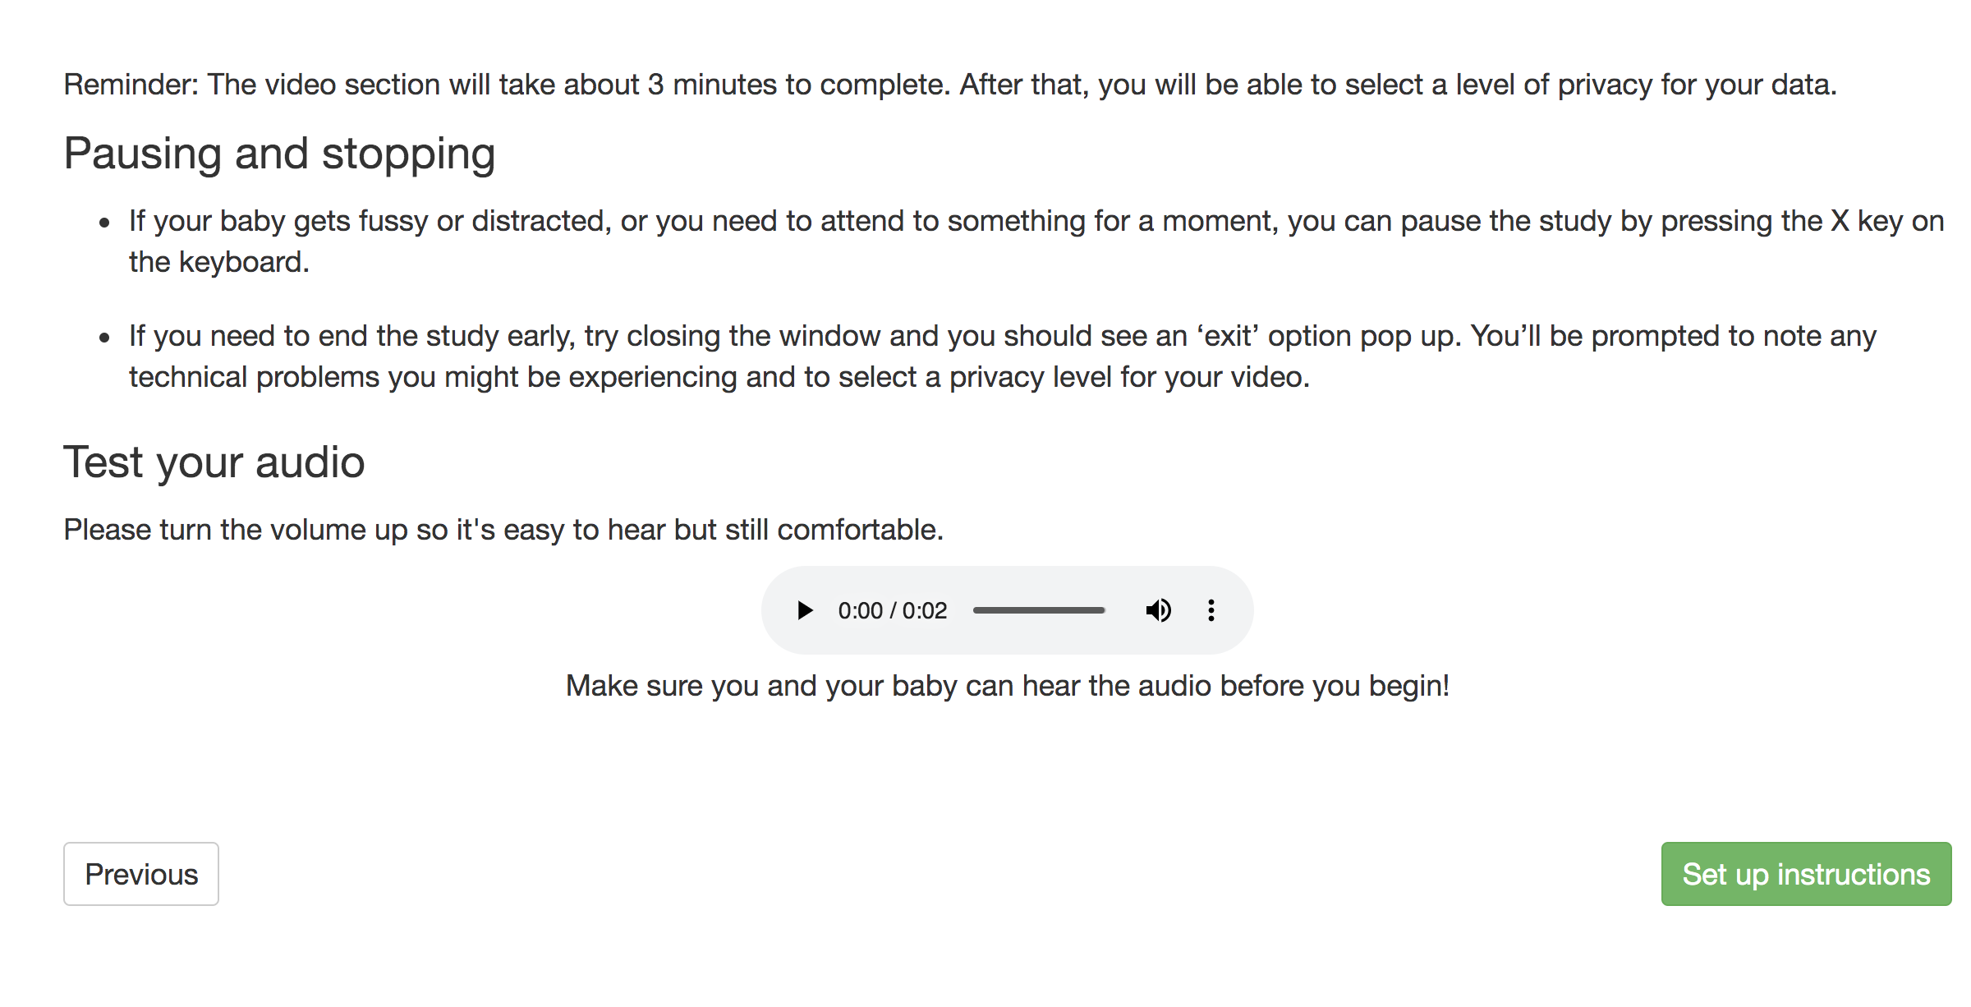
"sequence": [
"video-config",
"pre-study",
"video-consent",
"instructions-preview",
"final-instructions",
"cam-setup",
"webcam-display",
"test-trials",
"exit-survey"

Slide 14
CODE
LOOKIT VIEW
"final-instructions": {
"kind": "exp-lookit-instructions",
"blocks": [
{
"text": "Reminder: The video section will take about 3 minutes to complete. After that, you will be able to select a level of privacy for your data."
},
{
"title": "Pausing and stopping",
"listblocks": [
{
"text": "If your baby gets fussy or distracted, or you need to attend to something for a moment, you can pause the study by pressing the X key on the keyboard."
},
{
"text": "If you need to end the study early, try closing the window and you should see an ‘exit’ option pop up. You’ll be prompted to note any technical problems you might be experiencing and to select a privacy level for your video."
}
]
},
{
"text": "Please turn the volume up so it's easy to hear but still comfortable.",
"title": "Test your audio",
"mediaBlock": {
"text": "Make sure you and your baby can hear the audio before you begin!",
"isVideo": false,
"sources": [
{
"src": "https://raw.githubusercontent.com/ncuneo0711/lookit-stimuli-template/master/mp3/TestAudio.mp3",
"type": "audio/mp3"
},
{
"src": "https://raw.githubusercontent.com/ncuneo0711/lookit-stimuli-template/master/ogg/TestAudio.ogg",
"type": "audio/ogg"
}
],
"mustPlay": true,
"warningText": "Please try playing the sample audio."
}
}
]

Slide 15
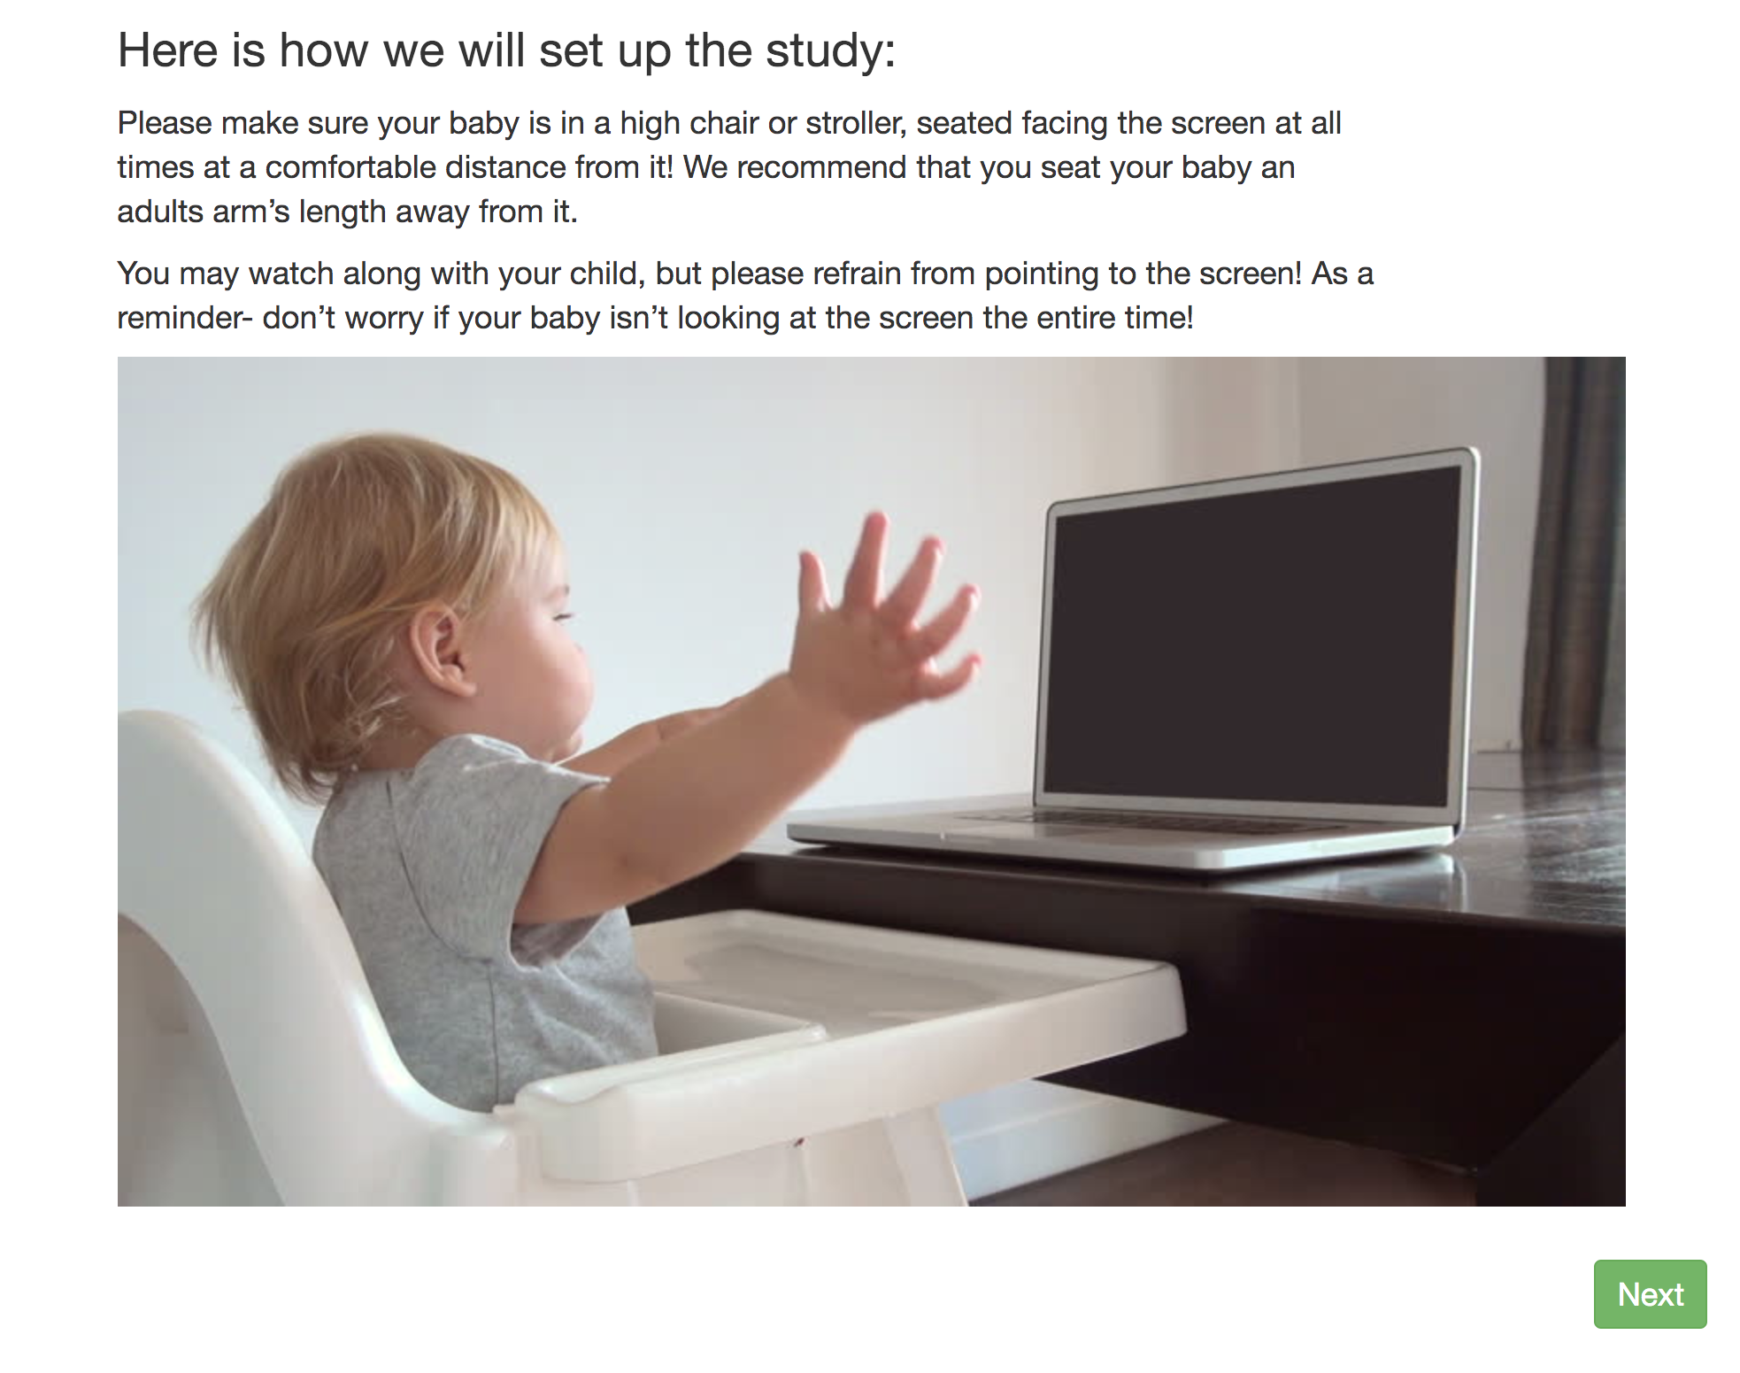
"sequence": [
"video-config",
"pre-study",
"video-consent",
"instructions-preview",
"final-instructions",
"cam-setup",
"webcam-display",
"test-trials",
"exit-survey"

Slide 16
CODE
LOOKIT VIEW
"cam-setup": {
"kind": "exp-lookit-text",
"blocks": [
{
"title": "Here is how we will set up the study:"
},{
"text": "Please make sure your baby is in a high chair or stroller, seated facing the screen at all times at a comfortable distance from it! We recommend that you seat your baby an adults arm’s length away from it."
},
{
"text": "You may watch along with your baby, but please refrain from pointing to the screen! As a reminder- don’t worry if your baby isn’t looking at the screen the entire time!"
},
{
"image": {
"alt": "Baby in a High Chair!",
"src": "https://raw.githubusercontent.com/ncuneo0711/lookit-stimuli-template/master/img/Setup.jpg"
}
}
],
"showPreviousButton": false,
}

Slide 17
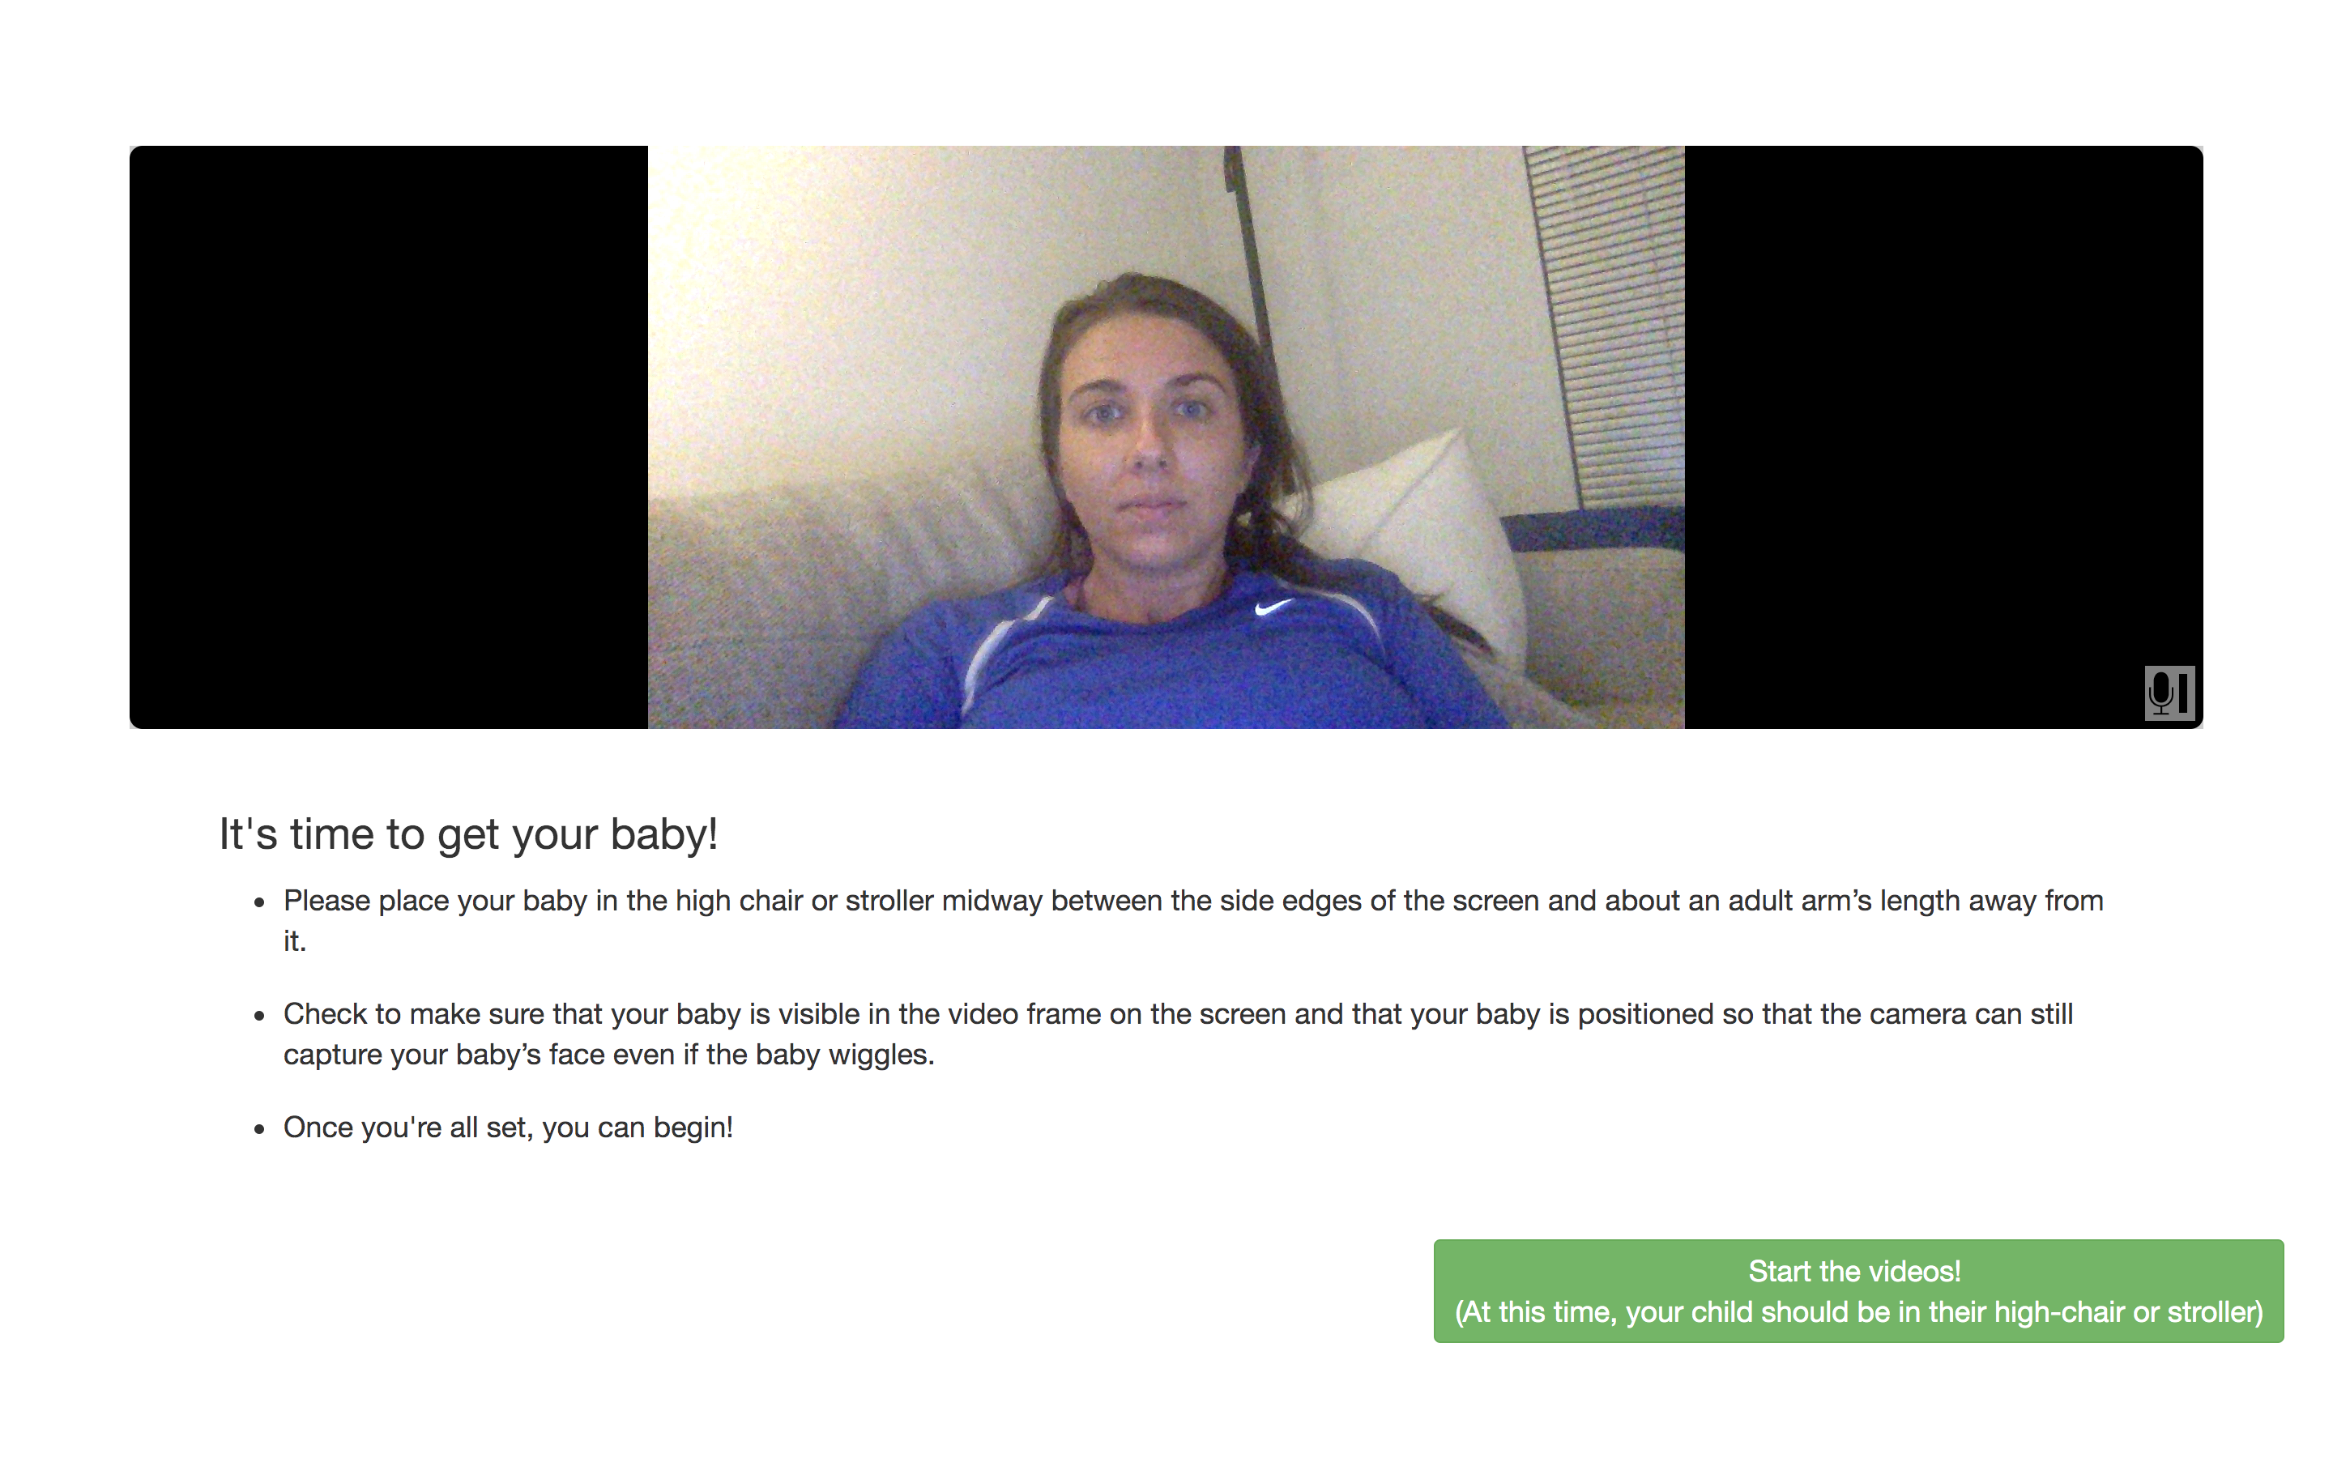
"sequence": [
"video-config",
"pre-study",
"video-consent",
"instructions-preview",
"final-instructions",
"cam-setup",
"webcam-display",
"test-trials",
"exit-survey"

Slide 18
CODE
LOOKIT VIEW
"webcam-display": {
"kind": "exp-lookit-webcam-display",
"blocks": [
{
"title": "It's time to get your baby!",
"listblocks": [
{
"text": "Please place your baby in the high chair or stroller midway between the side edges of the screen and about an adult arm’s length away from it."
},
{
"text": "Check to make sure that your baby is visible in the video frame on the screen and that your baby is positioned so that the camera can still capture your baby’s face even if the baby wiggles."
},
{
"text": "Once you're all set, you can begin!"
}
]
}
],
"nextButtonText": "Start the videos! \n (At this time, your child should be in their high-chair or stroller)",
"showPreviousButton": false,
"displayFullscreenOverride": true,
"startRecordingAutomatically": false
}

Slide 19
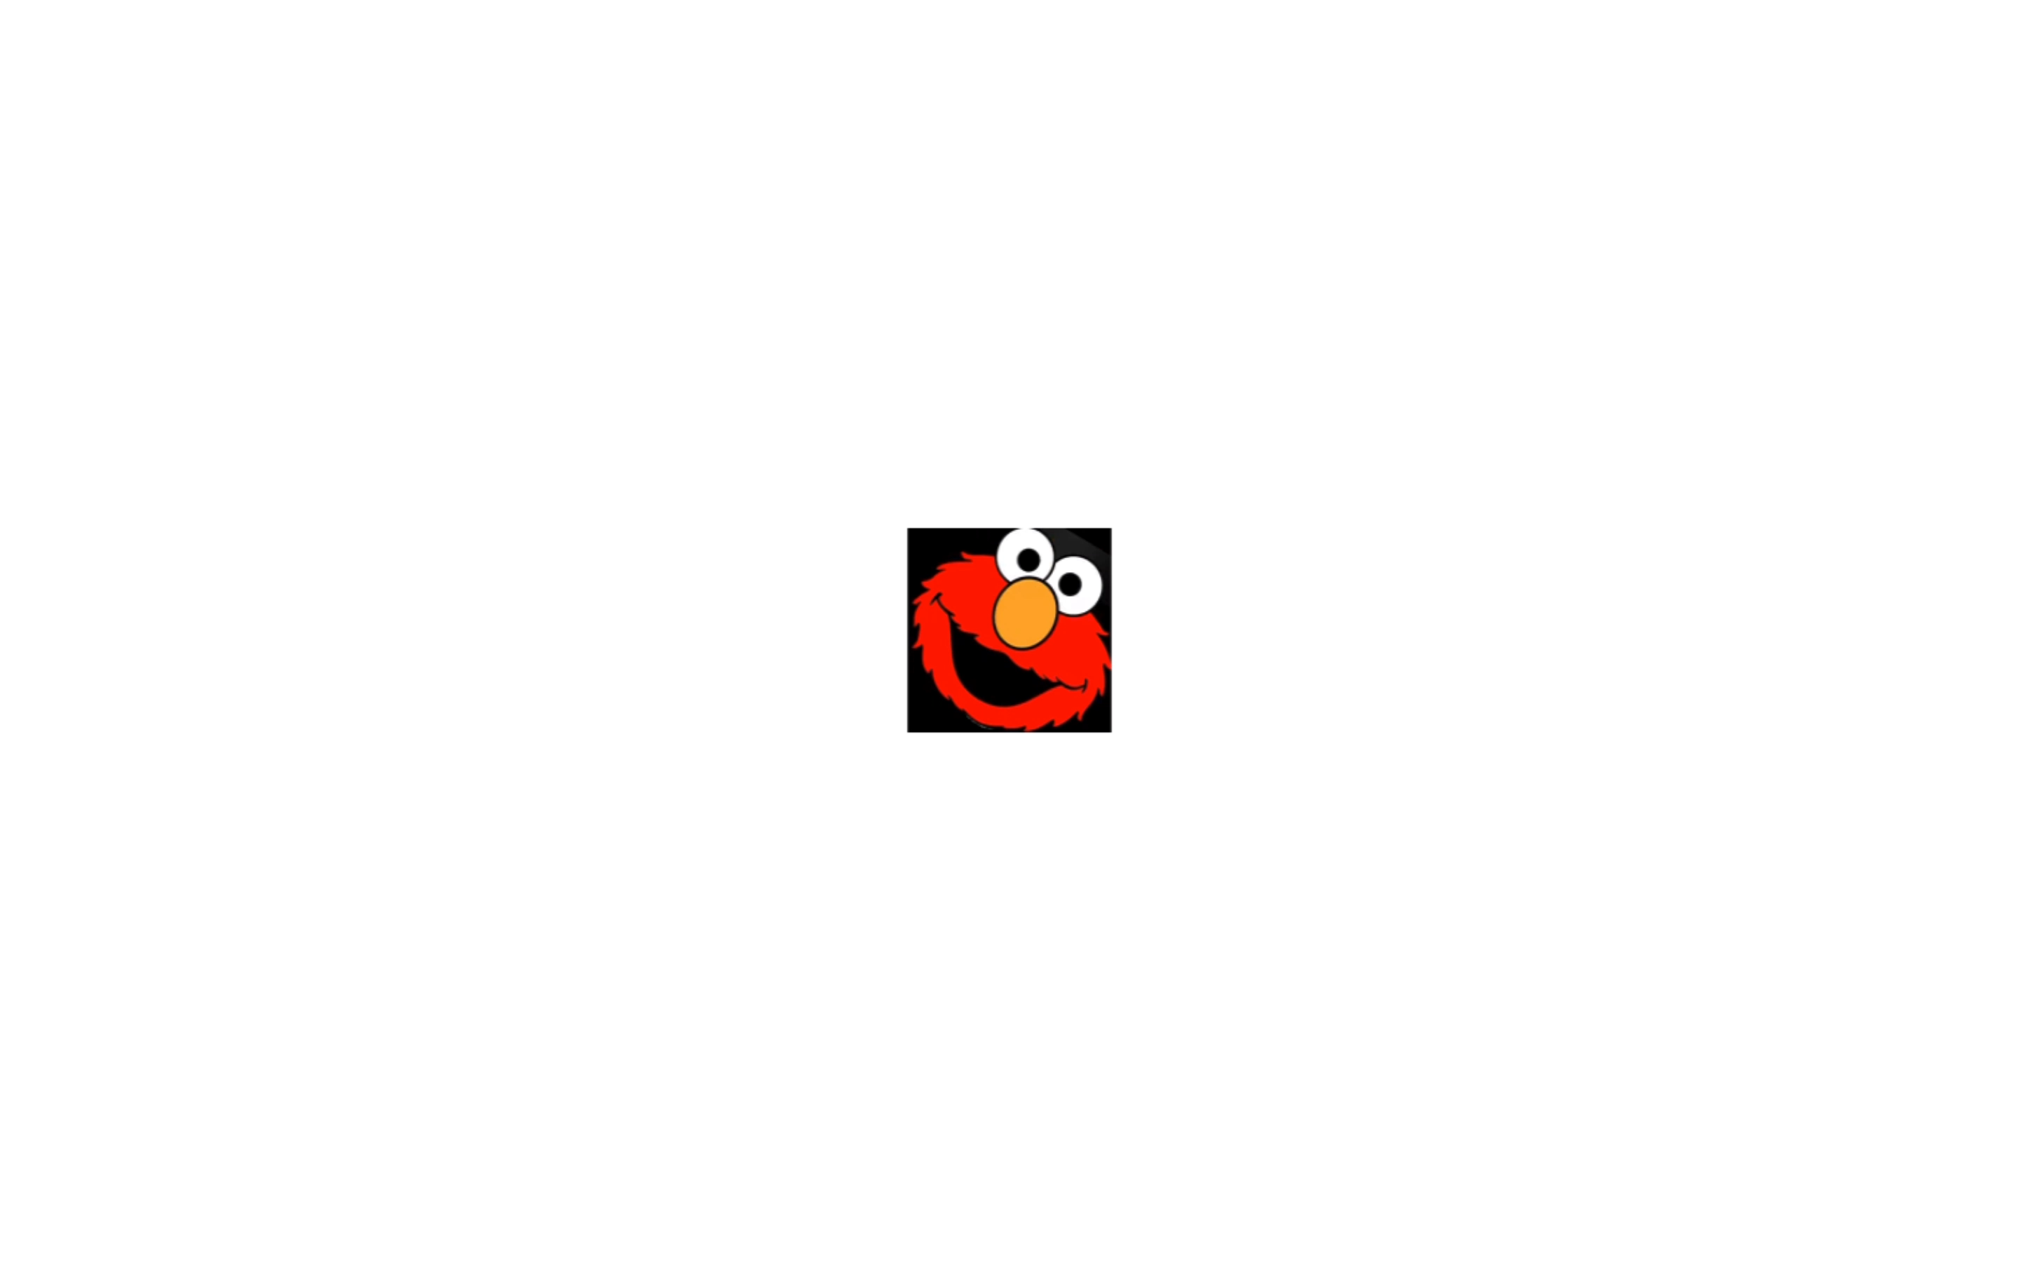
"sequence": [
"video-config",
"pre-study",
"video-consent",
"instructions-preview",
"final-instructions",
"cam-setup",
"webcam-display",
"test-trials",
"exit-survey"
**screen recording (the study has audio but this doesn’t!)

Slide 20
"test-trials": {
"kind": "choice",
"sampler": "random-parameter-set",
"frameList": [
{
"video": {
"loop": "false",
"source": "VIDEO1",
"position": "fill"
}
},
{
"video": {
"loop": "false",
"source": "VIDEO2",
"position": "fill"
}
},
{
"video": {
"loop": "false",
"source": "VIDEO3",
"position": "fill"
}
},
{
"video": {
"loop": "false",
"source": "VIDEO4",
"position": "fill"
}
}
],
These are the placeholders for videos
The videos/orders are specified after (next slide)

Slide 21
"test-trials": {
"kind": "choice",
"sampler": "random-parameter-set",
"frameList": [
{
"video": {
"loop": "false",
"source": "VIDEO1",
"position": "fill"
}
},
{
"video": {
"loop": "false",
"source": "VIDEO2",
"position": "fill"
}
},
{
"video": {
"loop": "false",
"source": "VIDEO3",
"position": "fill"
}
},
{
"video": {
"loop": "false",
"source": "VIDEO4",
"position": "fill"
}
}
],
Fill: the videos will fill to fit the screen. In this setting, the videos will maintain their original parameters
**There are ways to get around this, but not in this specific template

Slide 22
"parameterSets": [
{
"VIDEO1": "LLLS_32_1500",
"VIDEO2": "RLRS_32_1500",
"VIDEO3": "LLRS_32_1500",
"VIDEO4": "RLLS_32_1500"
},
{
"VIDEO1": "LLLS_32_1500",
"VIDEO2": "RLRS_32_1500",
"VIDEO3": "RLLS_32_1500",
"VIDEO4": "LLRS_32_1500"
},
{
"VIDEO1": "RLRS_32_1500",
"VIDEO2": "LLLS_32_1500",
"VIDEO3": "LLRS_32_1500",
"VIDEO4": "RLLS_32_1500"
},
{
"VIDEO1": "RLRS_32_1500",
"VIDEO2": "LLLS_32_1500",
"VIDEO3": "RLLS_32_1500",
"VIDEO4": "LLRS_32_1500"
},
{
"VIDEO1": "LLLS_49_1500",
"VIDEO2": "RLRS_49_1500",
"VIDEO3": "LLRS_49_1500",
"VIDEO4": "RLLS_32_1500"
}
]
This is a fixed order design (meaning I wrote out all the possible orders). You can use a randomizer or a nested randomizer (to randomize within randomization) if your study is too complicated to list out each order.

Slide 23
"commonFrameProperties": {
"kind": "exp-lookit-video",
"baseDir": "https://raw.githubusercontent.com/ncuneo0711/lookit-stimuli-template/master/",
"pauseKey": "x",
"pauseText": "(You'll have a moment to turn around again.)",
"testCount": 2,
"audioTypes": [
"mp3",
"ogg"
],
"pauseAudio": "Pause",
"pauseVideo": "elmono",
"videoTypes": [
"mp4",
"webm"
],
"autoProceed": true,
"unpauseAudio": "Resume",
"backgroundColor": "white",
"requiredDuration": 0,
"restartAfterPause": true,
"requiredAudioCount": 0,
"requiredVideoCount": 1,
"pauseKeyDescription": "X"
}
}
This is a feature that allows you to specify features that are the same across all videos

Slide 24
"commonFrameProperties": {
"kind": "exp-lookit-video",
"baseDir": "https://raw.githubusercontent.com/ncuneo0711/lookit-stimuli-template/master/",
"pauseKey": "x",
"pauseText": "(You'll have a moment to turn around again.)",
"testCount": 2,
"audioTypes": [
"mp3",
"ogg"
],
"pauseAudio": "Pause",
"pauseVideo": "elmono",
"videoTypes": [
"mp4",
"webm"
],
"autoProceed": true,
"unpauseAudio": "Resume",
"backgroundColor": "white",
"requiredDuration": 0,
"restartAfterPause": true,
"requiredAudioCount": 0,
"requiredVideoCount": 1,
"pauseKeyDescription": "X"
}
}
<- Videos play in full screen
<- Location of stored videos
<- For parents to pause the study
<- When the study is paused
<- Audio files
<- Audio file for when the study pauses
<- Video file for when the study pauses
<- Videos files
<- Once a test trial ends, the next one begins (without having the parent click next)
<- Audio file for when the study resumes
<- Background of screen that does not have video; beneficial to keep white (to maximize light on infants face)
<- Replays video that was paused (you can have it progress to a different video)

Slide 25
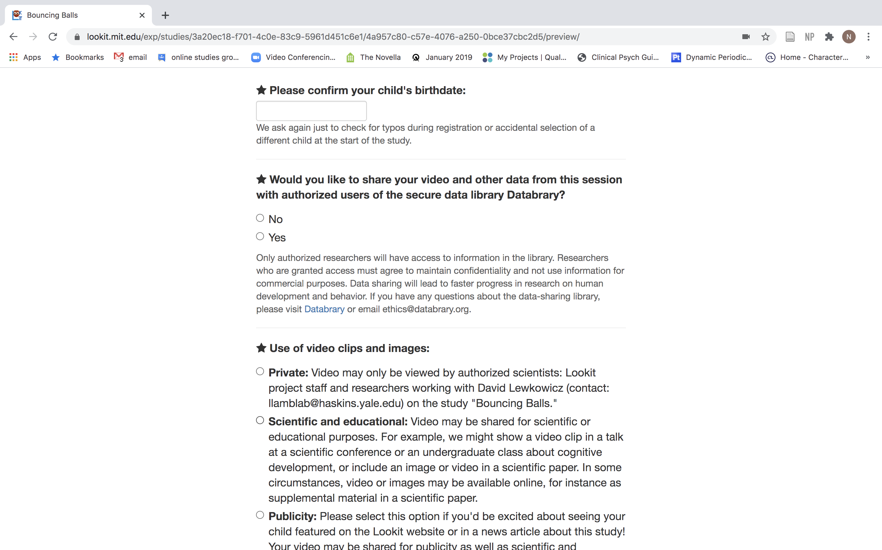
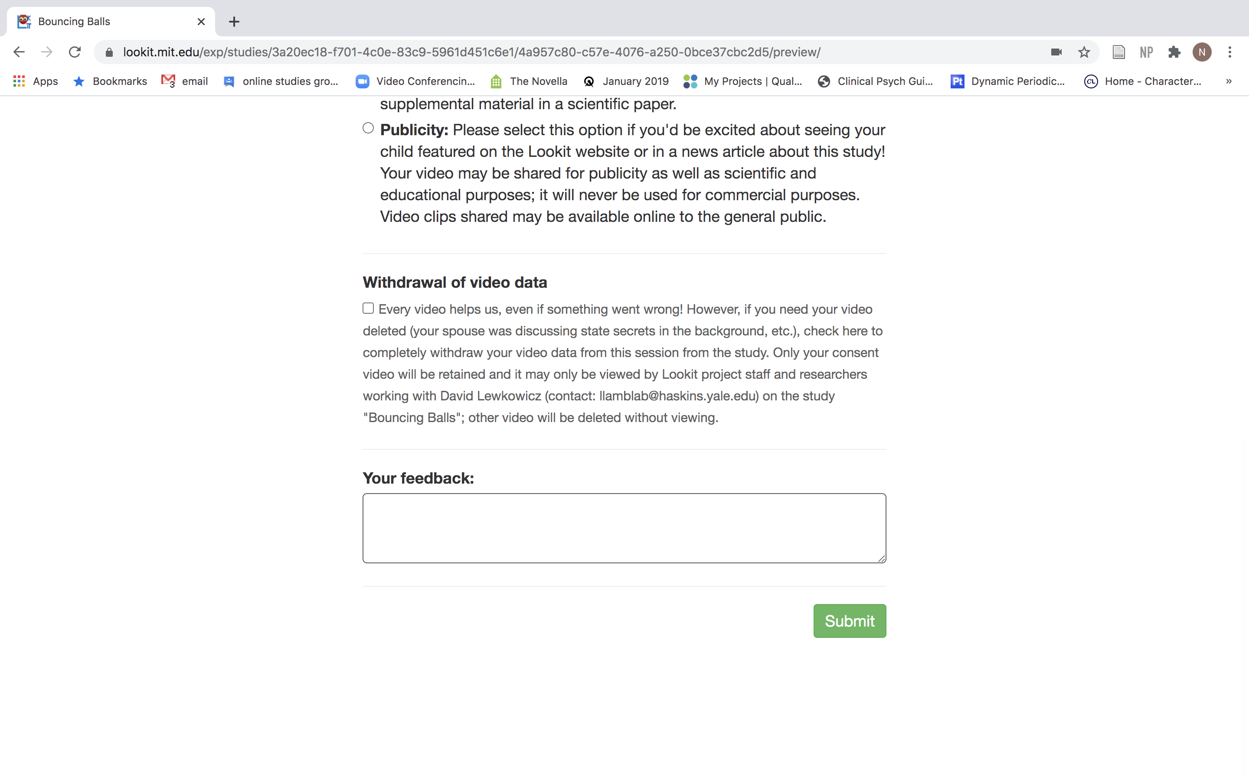

Slide 26
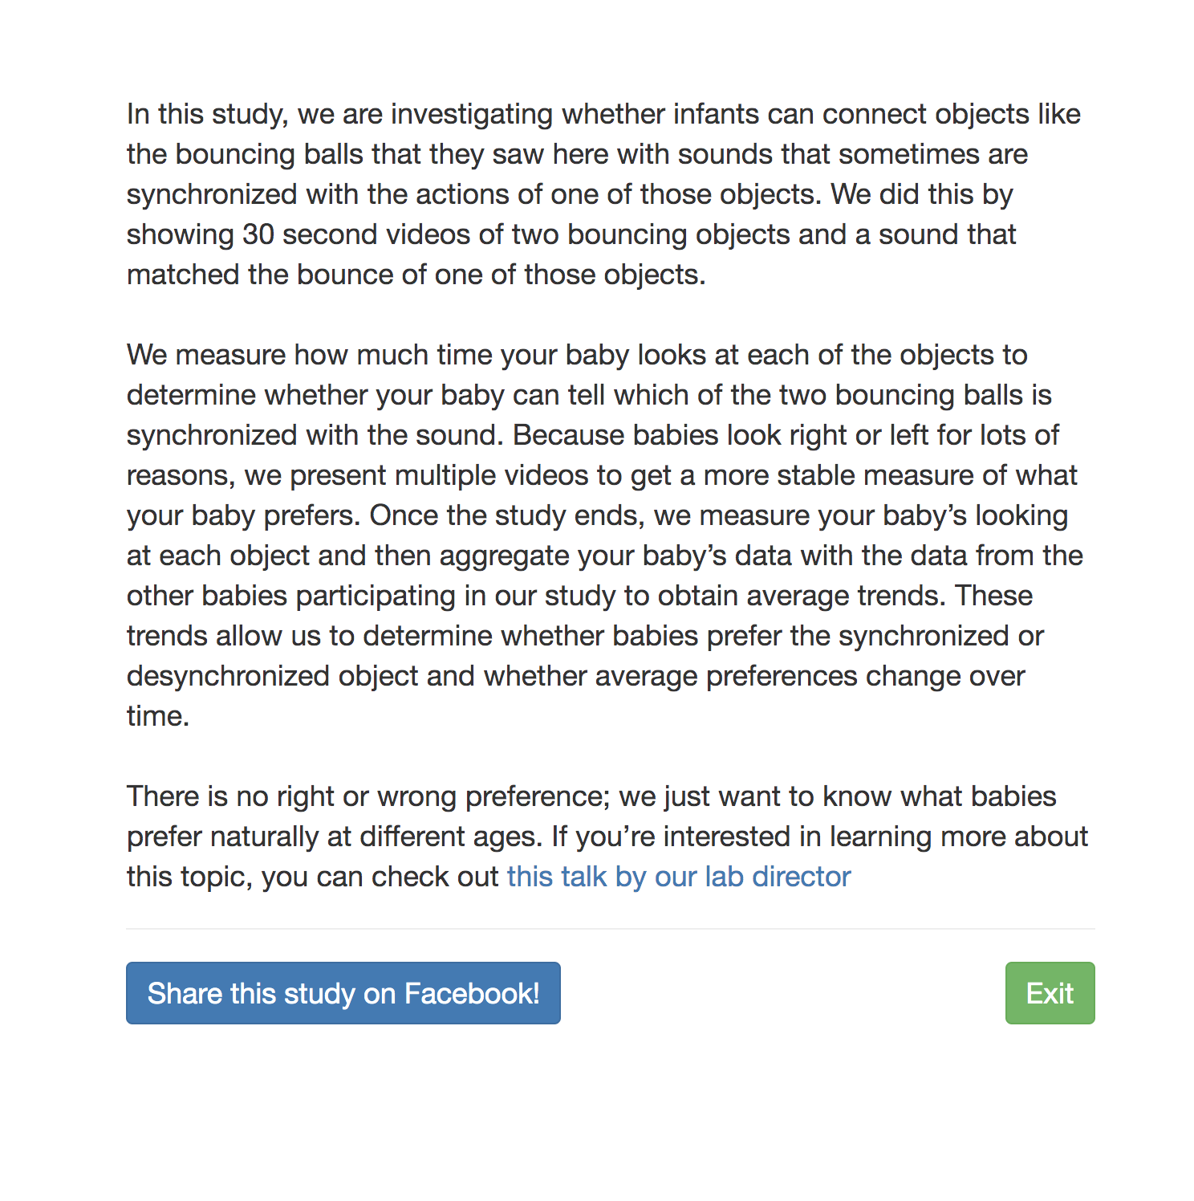
"sequence": [
"video-config",
"pre-study",
"video-consent",
"instructions-preview",
"final-instructions",
"cam-setup",
"webcam-display",
"test-trials",
"exit-survey"

Slide 27
CODE
LOOKIT VIEW
"exit-survey": {
"kind": "exp-lookit-exit-survey",
"debriefing": {
"text": "In this study, we are investigating whether infants can connect objects like the bouncing balls that they saw here with sounds that sometimes are synchronized with the actions of one of those objects. We did this by showing 30 second videos of two bouncing objects and a sound that matched the bounce of one of those objects. \n\n We measure how much time your baby looks at each of the objects to determine whether your baby can tell which of the two bouncing balls is synchronized with the sound. Because babies look right or left for lots of reasons, we present multiple videos to get a more stable measure of what your baby prefers. Once the study ends, we measure your baby’s looking at each object and then aggregate your baby’s data with the data from the other babies participating in our study to obtain average trends. These trends allow us to determine whether babies prefer the synchronized or desynchronized object and whether average preferences change over time. \n\n There is no right or wrong preference; we just want to know what babies prefer naturally at different ages. If you’re interested in learning more about this topic, you can check out <a href=”https://www.youtube.com/watch?v=eH5qxw6Pd1c” rel=”noopener”>this talk by our lab director</a>"
}
}

Slide 28
CODE
LOOKIT VIEW
"exit-survey": {
"kind": "exp-lookit-exit-survey",
"debriefing": {
"text": "In this study, we are investigating whether infants can connect objects like the bouncing balls that they saw here with sounds that sometimes are synchronized with the actions of one of those objects. We did this by showing 30 second videos of two bouncing objects and a sound that matched the bounce of one of those objects. \n\n We measure how much time your baby looks at each of the objects to determine whether your baby can tell which of the two bouncing balls is synchronized with the sound. Because babies look right or left for lots of reasons, we present multiple videos to get a more stable measure of what your baby prefers. Once the study ends, we measure your baby’s looking at each object and then aggregate your baby’s data with the data from the other babies participating in our study to obtain average trends. These trends allow us to determine whether babies prefer the synchronized or desynchronized object and whether average preferences change over time. \n\n There is no right or wrong preference; we just want to know what babies prefer naturally at different ages. If you’re interested in learning more about this topic, you can check out <a href=”https://www.youtube.com/watch?v=eH5qxw6Pd1c” rel=”noopener”>this talk by our lab director</a>"
}
}
For a directly clickable link!

Slide 29
CODE
LOOKIT VIEW
"exit-survey": {
"kind": "exp-lookit-exit-survey",
"debriefing": {
"text": "In this study, we are investigating whether infants can connect objects like the bouncing balls that they saw here with sounds that sometimes are synchronized with the actions of one of those objects. We did this by showing 30 second videos of two bouncing objects and a sound that matched the bounce of one of those objects. \n\n We measure how much time your baby looks at each of the objects to determine whether your baby can tell which of the two bouncing balls is synchronized with the sound. Because babies look right or left for lots of reasons, we present multiple videos to get a more stable measure of what your baby prefers. Once the study ends, we measure your baby’s looking at each object and then aggregate your baby’s data with the data from the other babies participating in our study to obtain average trends. These trends allow us to determine whether babies prefer the synchronized or desynchronized object and whether average preferences change over time. \n\n There is no right or wrong preference; we just want to know what babies prefer naturally at different ages. If you’re interested in learning more about this topic, you can check out <a href=”https://www.youtube.com/watch?v=eH5qxw6Pd1c” rel=”noopener”>this talk by our lab director</a>"
}
}
If you don’t want this feature:
https://lookit.github.io/lookit-frameplayer-docs/classes/Exp-lookit-exit-survey.html#property_showShareButton

